Slide 1
Operating System System Calls
Tahira Alam

Slide 2
System Call
A system call is the programmatic way in which a computer program requests a service from the kernel of the operating system on which it is executed.
Example: fork, exec etc.

Slide 3
Services Provided by System Calls
Process creation and management
Main memory management
File Access, Directory and File system management
Device handling(I/O)
Protection
Networking etc.

Slide 4
Types of System Calls
Process control: end, abort, create, terminate, allocate and free memory.
File management: create, open, close, delete, read file etc.
Device management
Information maintenance
Communication

Slide 5
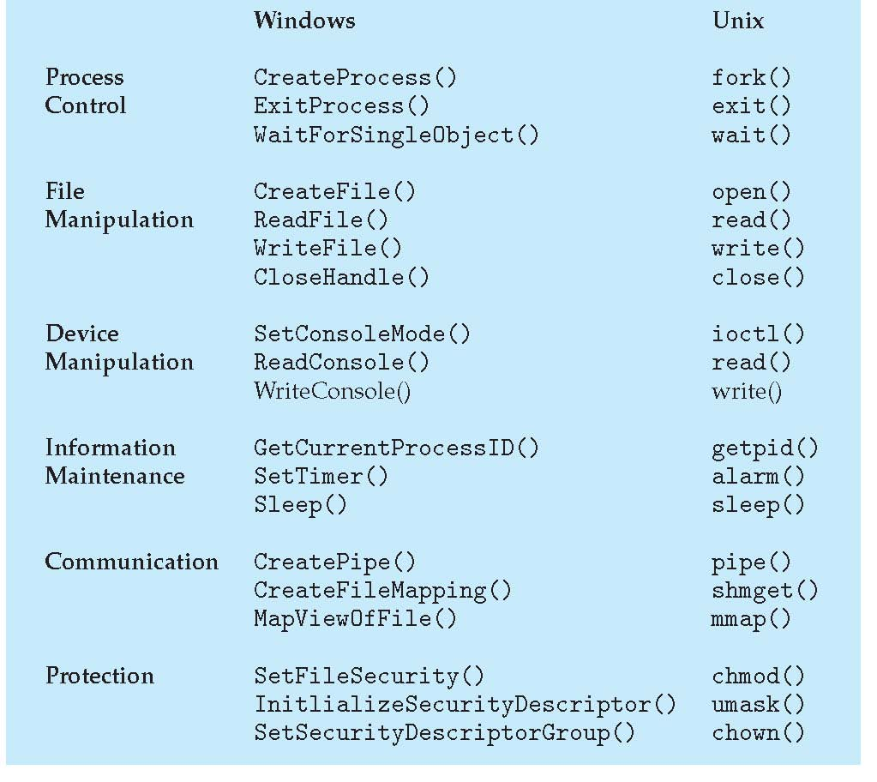
Examples:

Slide 6
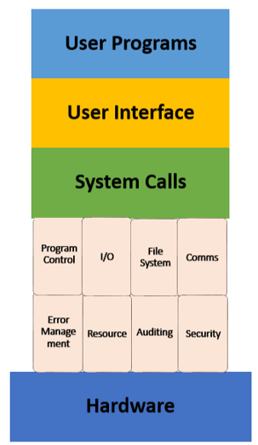
How does it work(1)

Slide 7
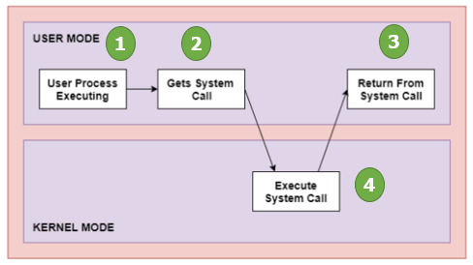
How does it work(2)

Slide 8
Operating System Services
One set of operating-system services provides functions that are helpful to the user:
Communications – Processes may exchange information, on the same computer or between computers over a network
Communications may be via shared memory or through message passing (packets moved by the OS)
Error detection – OS needs to be constantly aware of possible errors
May occur in the CPU and memory hardware, in I/O devices, in user program
For each type of error, OS should take the appropriate action to ensure correct and consistent computing
Debugging facilities can greatly enhance the user’s and programmer’s abilities to efficiently use the system

Slide 9
Operating System Services(2)
Another set of OS functions exists for ensuring the efficient operation of the system itself via resource sharing
Resource allocation - When multiple users or multiple jobs running concurrently, resources must be allocated to each of them
Many types of resources - Some (such as CPU cycles, main memory, and file storage) may have special allocation code, others (such as I/O devices) may have general request and release code
Accounting - To keep track of which users use how much and what kinds of computer resources

Slide 10
Operating System Services(3)
Protection and security - The owners of information stored in a multiuser or networked computer system may want to control use of that information, concurrent processes should not interfere with each other
Protection involves ensuring that all access to system resources is controlled
Security of the system from outsiders requires user authentication, extends to defending external I/O devices from invalid access attempts
If a system is to be protected and secure, precautions must be instituted throughout it. A chain is only as strong as its weakest link.

Slide 11
What API does the OS provide to user programs?
API = Application Programming Interface
= functions available to write user programs
• API provided by OS is a set of “system calls”
– System call is a function call into OS code that runs at
a higher privilege level of the CPU
– Sensitive operations (e.g., access to hardware) are
allowed only at a higher privilege level
– Some “blocking” system calls cause the process to be
blocked and descheduled (e.g., read from disk)

Slide 12
So, should we rewrite programs for each OS?
POSIX API: a standard set of system calls that an OS
must implement
– Programs written to the POSIX API can run on any POSIX
compliant OS
– Most modern OSes are POSIX compliant
– Ensures program portability
• Program language libraries hide the details of invoking
system calls
– The printf function in the C library calls the write system
call to write to screen
– User programs usually do not need to worry about
invoking system calls

Slide 13
Process related system calls (in Unix)
fork() creates a new child process
– All processes are created by forking from a parent
– The init process is ancestor of all processes
• exec() makes a process execute a given
executable
• exit() terminates a process
• wait() causes a parent to block until child
terminates
• Many variants exist of the above system calls with
different arguments

Slide 14
What happens during a fork?
P
C
A new process is created
by making a copy of
parent’s memory image
• The new process is added
to the OS process list and
scheduled
• Parent and child start
execution just after fork
(with different return
values)
• Parent and child execute
and modify the memory
data independently
.
.
fork()
Code
data
.
.
.
.
fork()
Code
data
.
.

Slide 15

#include <stdio.h>
#include <stdlib.h>
#include <unistd.h>
int main(int argc, char *argv[]) {
printf("hello world (pid:%d)\n", (int) getpid());
int rc = fork();
if (rc < 0) { //fork fails
fprintf(stderr, "fork failed\n");
} else if (rc == 0) { //new process (children)
printf("hello, I am child (pid:%d)\n", (int) getpid());
} else { // parent(the main process)
printf("hello, I am parent of %d (pid:%d)\n", rc, (int) getpid());
}
return 0;
}

Slide 16
Waiting for children to die…
Process termination scenarios
– By calling exit() (exit is called automatically when
end of main is reached)
– OS terminates a misbehaving process
• Terminated process exists as a zombie
• When a parent calls wait(), zombie child is
cleaned up or “reaped”
• wait() blocks in parent until child terminates
(non-blocking ways to invoke wait exist)
• What if parent terminates before child? init
process adopts orphans and reaps them
P
C
init
P
C

Slide 17
#include <stdio.h>
#include <stdlib.h>
#include <unistd.h>
#include <sys/wait.h>
int main(int argc, char *argv[]) {
printf("hello world (pid:%d)\n", (int) getpid());
int rc = fork();
if (rc < 0) {
fprintf(stderr, "fork failed\n");
exit(1);
} else if (rc == 0) {
printf("hello, I am child (pid:%d)\n", (int) getpid());
} else {
int wc = wait(NULL);
printf("hello, I am parent of %d (wc:%d) (pid:%d)\n", rc, wc, (int) getpid());
}
return 0;
}

Slide 18
Some facts…
Resource sharing
Parent and children share all resources
Children share subset of parent’s resources
Parent and child share no resources
Execution
Parent and children execute concurrently
Parent waits until children terminate

Slide 19
What happens during exec?
P
C
After fork, parent and child
are running same code
– Not too useful!
• A process can run exec() to
load another executable to its
memory image
– So, a child can run a different
program from parent
• Variants of exec(), e.g., to
pass command line arguments
to new executable
.
.
fork()
.
.
New code
New data
.
.

Slide 20
#include <stdio.h>
#include <stdlib.h>
#include <unistd.h>
#include <string.h>
#include <sys/wait.h>
int main(int argc, char *argv[]) {
printf("hello world (pid:%d)\n", (int) getpid());
int rc = fork();
if (rc < 0) {
fprintf(stderr, "fork failed\n");
exit(1);
} else if (rc == 0) {
printf("hello, I am child (pid:%d)\n", (int) getpid());
char *myargs[3];
myargs[0] = strdup("wc");
myargs[1] = strdup("p3.c");
myargs[2] = NULL;
execvp(myargs[0], myargs);
printf("this shouldn't print out");
} else {
int wc = wait(NULL);
printf("hello, I am parent of %d (wc:%d) (pid:%d)\n", rc, wc, (int) getpid());
}
return 0;
}

Slide 21
Case study: How does a shell work?
In a basic OS, the init process is created after initialization of hardware
• The init process spawns a shell like bash
• Shell reads user command, forks a child, execs the command
executable, waits for it to finish, and reads next command
• Common commands like ls are all executables that are
simply exec’ed by the shell
prompt>ls
a.txt b.txt c.txt
init
fork()
exec(ls)

Slide 22
More funky things about the shell
shell
Shell can manipulate the
child in strange ways
• Suppose you want to redirect
output from a command to a
file
• prompt>ls > foo.txt
• Shell spawns a child, rewires
its standard output to a file,
then calls exec on the child
ls
screen
foo.txt

Slide 23
#include <stdio.h>
#include <stdlib.h>
#include <unistd.h>
#include <string.h>
#include <fcntl.h>
#include <sys/wait.h>
int main(int argc, char *argv[]) {
printf("hello world (pid:%d)\n", (int) getpid());
int rc = fork();
if (rc < 0) {
fprintf(stderr, "fork failed\n");
exit(1);
} else if (rc == 0) {
close(STDOUT_FILENO); //close standard output
open("./p4.output", O_CREAT | O_WRONLY | O_TRUNC, S_IRWXU); // open a file for showing output
char *myargs[3];
myargs[0] = strdup("wc");
myargs[1] = strdup("p4.c");
myargs[2] = NULL;
execvp(myargs[0], myargs);
} else {
int wc = wait(NULL);
}
return 0;
}

Slide 24
Thank You!!!!!

